Slide 1

Code-Free Introduction to GitHub
BY Faizan khalid mohsin

Slide 2
Overview
Hands on Experience:
Creating GitHub Account
• GitHub Handle
• Your Profile
Creating a Repository on GitHub
• README file
• Licenses
Uploading files to a GitHub Repository
Downloading entire GitHub Repository or certain files.
Slides:
GitHub Features
• Pinning Repos
• Activity Statistics

Slide 3


Slide 5
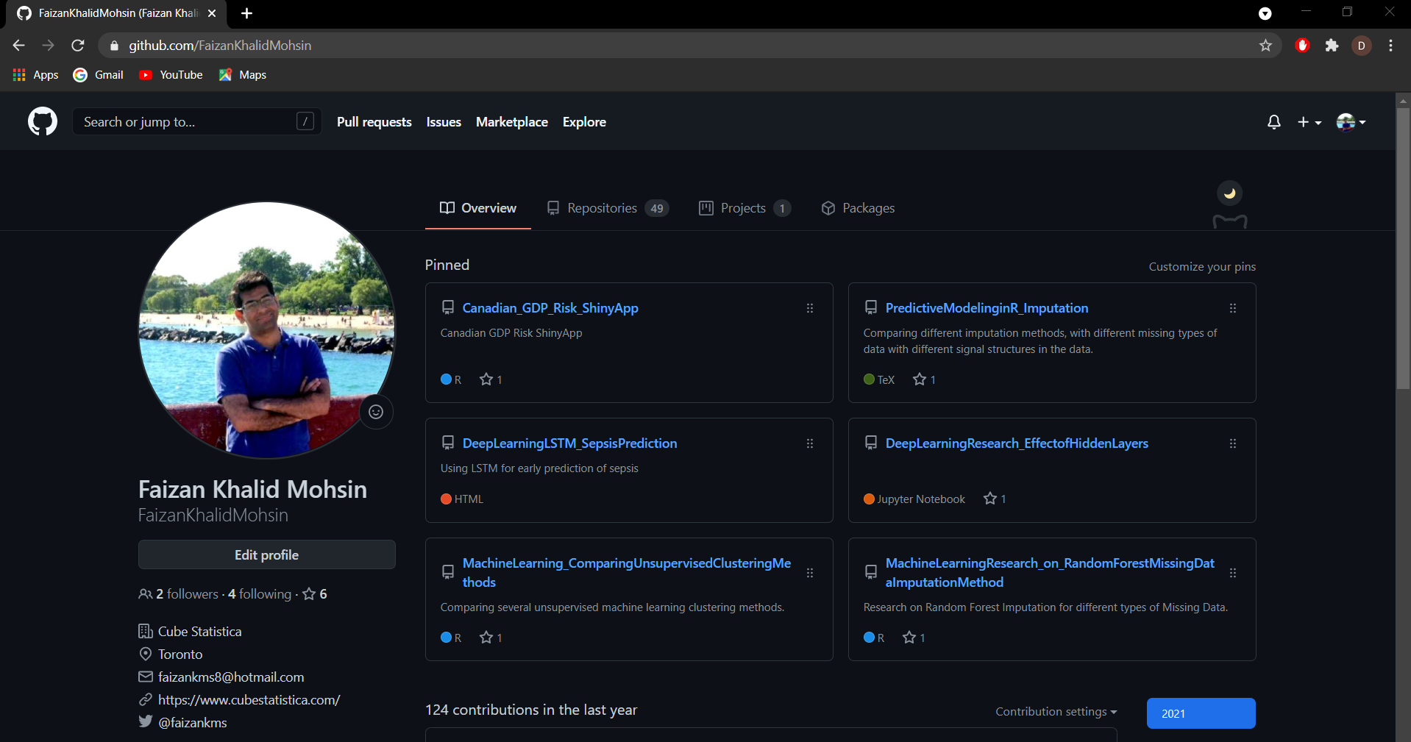
My GitHub Repository
My GitHub Page.

Slide 6
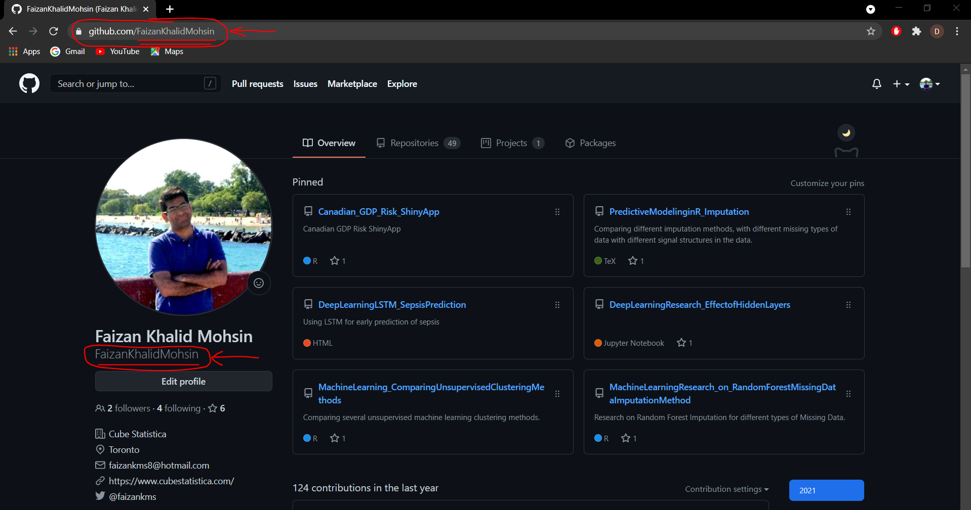

Slide 7
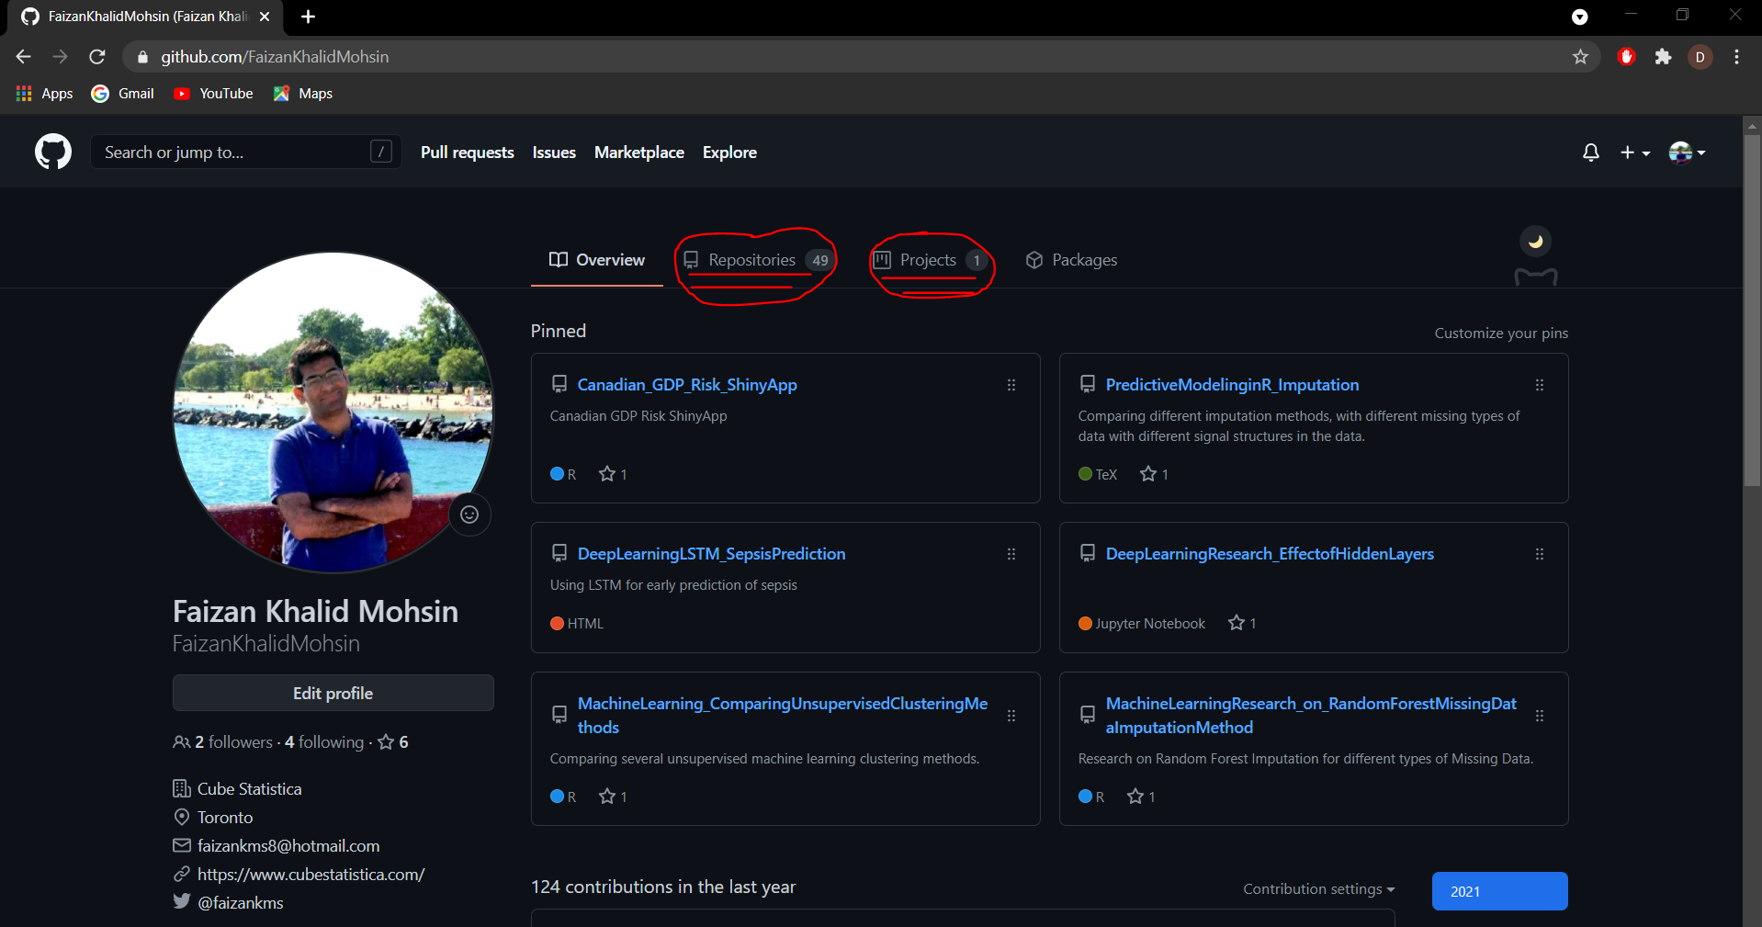

Slide 8
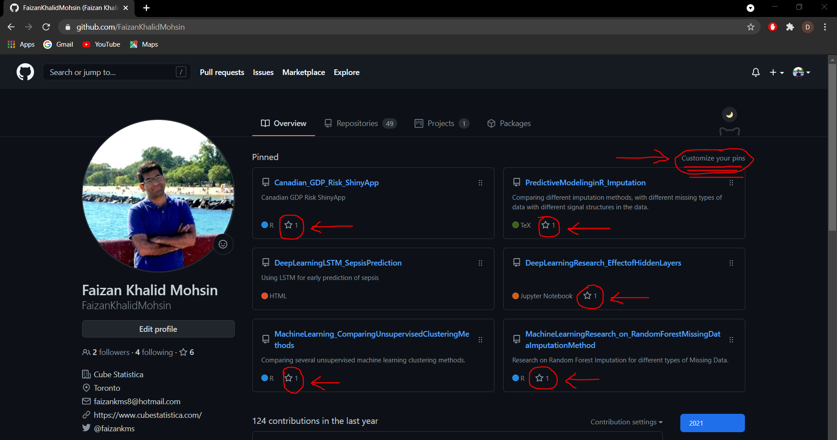

Slide 9
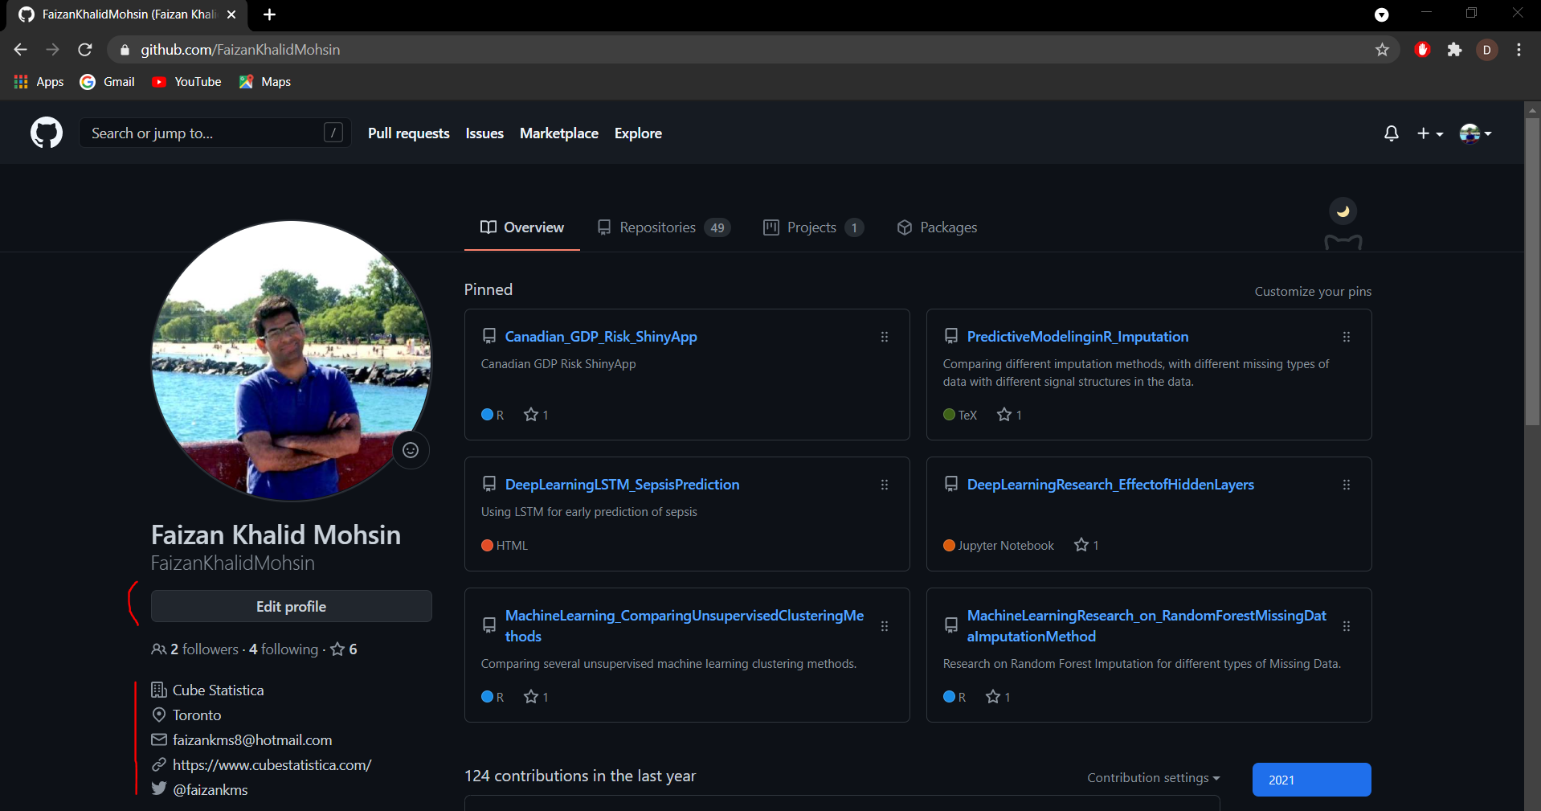

Slide 10
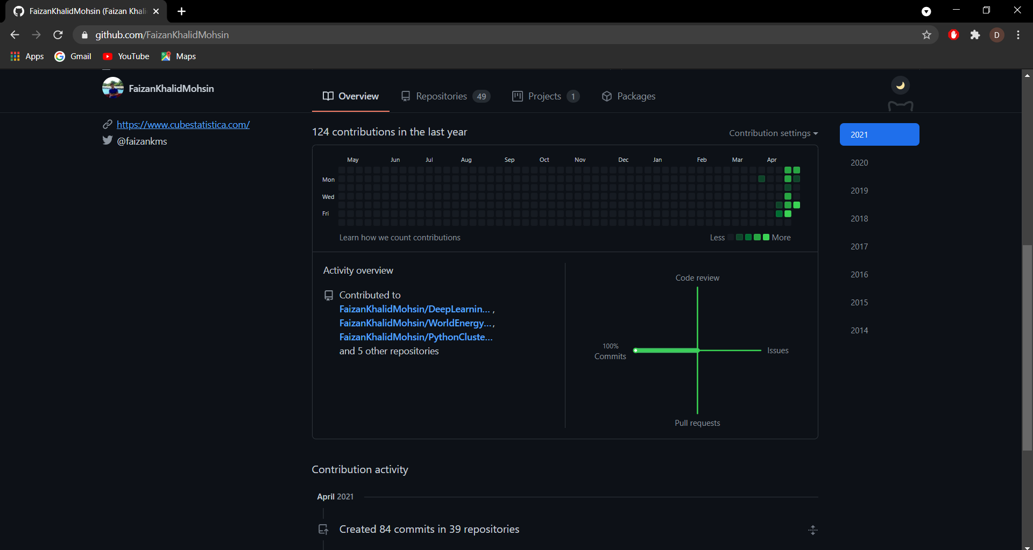

Slide 11
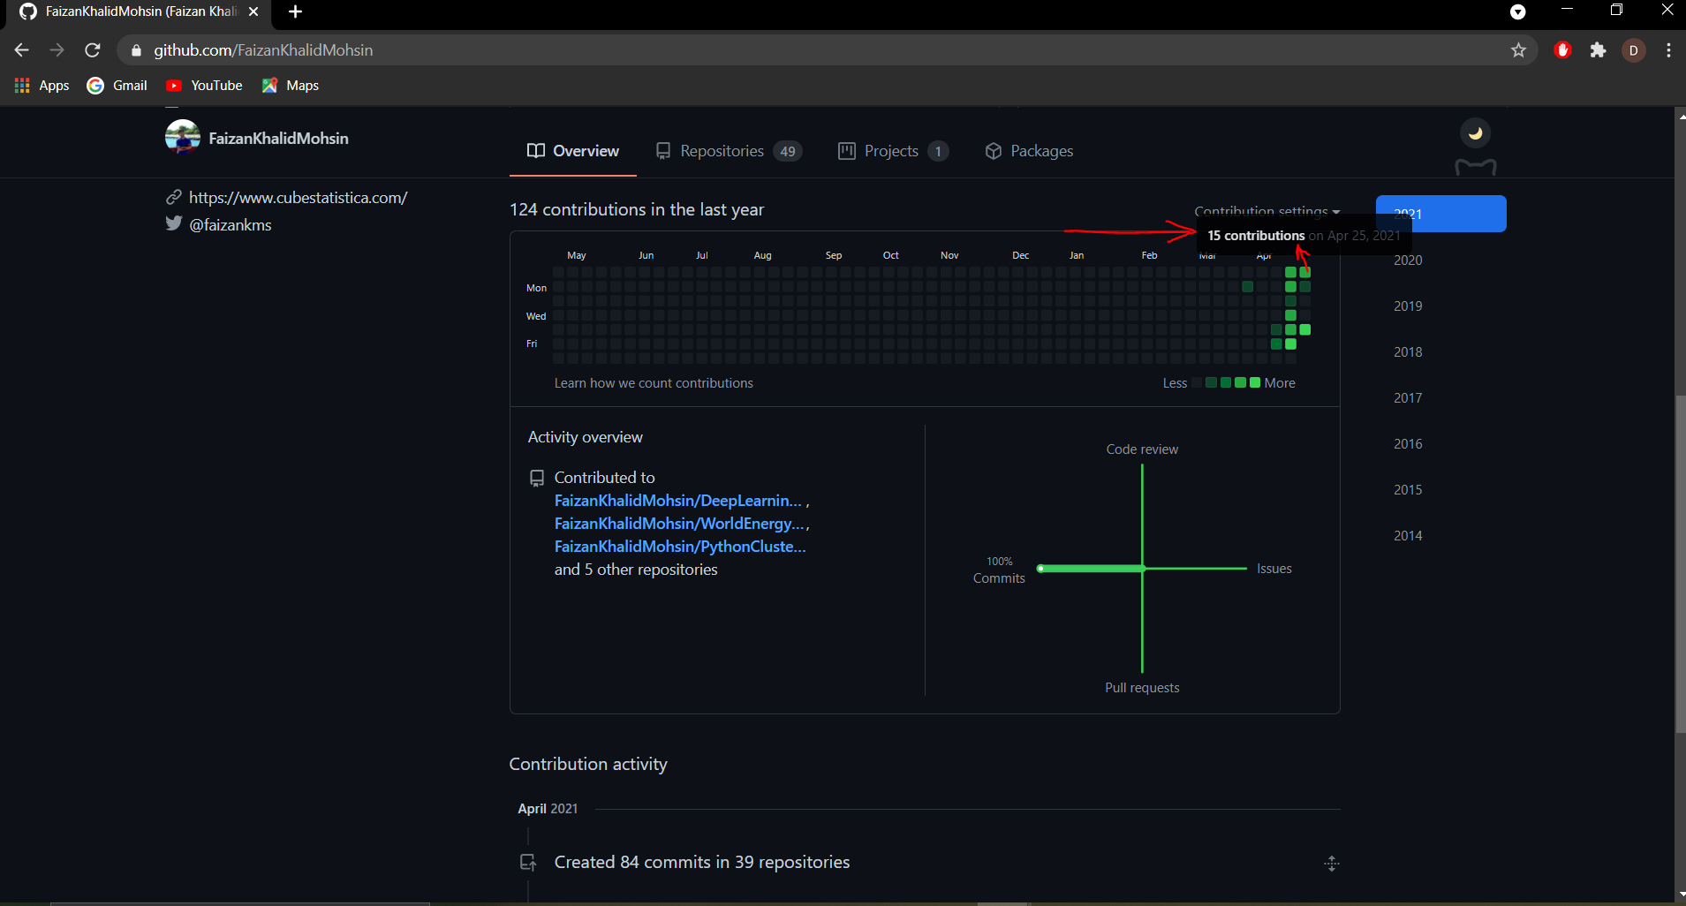

Slide 12

The Octagon Cat

Slide 13


Code-Free Introduction to GitHub by Faizan Khalid Mohsin
Questions?
www.linkedin.com/in/faizan-khalid-mohsin/
www.github.com/FaizanKhalidMohsin
@faizankms

Slide 14
The Octagon Cat
Faizan Khalid Mohsin | linkedin.com/in/faizan-khalid-mohsin/ | github.com/FaizanKhalidMohsin @faizankms

